Slide 1

People Serving People
CIGNA HEALTHCARE, INTERNATIONAL HEALTH
Partners of The Americas Inc.
Policy # 10123A
Offered by Cigna Healthcare and Life Insurance Company or its affiliates

Slide 2
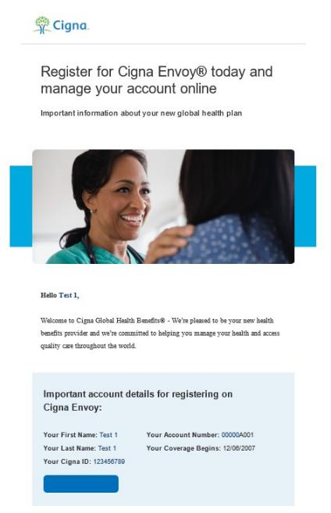
Welcome to Cigna Healthcare
For details on your new global health insurance program you can request a copy of your summary of benefits from your human resources department, or once you log on and register on the customer website, www.cignaenvoy.com you can view details on your program or simply call Cigna Healthcare at 1.800.441.2668.
Prior to May 1, 2024, please submit any claims incurred prior to 5/1/2024 to your previous health insurance company.
Your new Cigna Healthcare global program begins May 1, 2024
Take a moment to view our Welcome video
Cigna Healthcare will send you an email prior to 5/1/2024 with your new customer ID and registration instructions for the Cigna Healthcare secure customer website.
Register for Cigna Envoy, your personalized online health resource. The tools and information are developed specifically for globally mobile individuals so you can easily find what you need.
Find a health care provider or facility anywhere in the world
Review and submit claims
View and print ID cards
Access to country guides
And more!

Slide 3
Putting you first

Slide 4

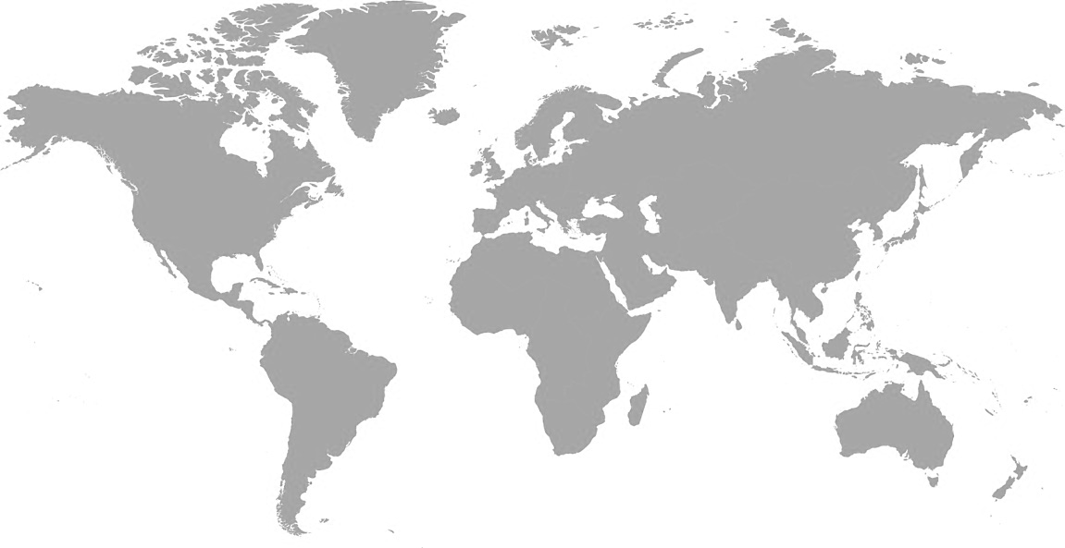
You can’t have global without local.
Our people all over the world support the health of members.
CANADA
MINNESOTA
UK
BELGIUM
NEVADA
CHINA
1.7+ | Million in-network providers¹
200+ | Countries and jurisdictions²
2,800 | Dedicated global team members²
39+ | Global care management staff
325k+ | CignaLinks® providers outside the U.S.⁴
50+ | Dedicated payment integrity team³
40+ | Lawyers, compliance and privacy team members⁵
CALIFORNIA
DELAWARE
SPAIN
MIDDLE EAST
KOREA
FLORIDA
KUWAIT
DUBAI
HONG KONG
NIGERIA
SAUDI ARABIA
THAILAND
GUAM
ECUADOR
INDIA
PHILIPPINES
BRAZIL
KENYA
MALAYSIA
SINGAPORE
MOZAMBIQUE
INDONESIA
SOUTH AFRICA
AUSTRALIA
250 | 105 | 12 | 10
Clinical resources² (key locations shown) | Network resources² (key locations shown) | International service centers | CignaLinks® partners (partners may cover multiple countries)
Dedicated provider advocacy team
Data from GHB Network analysis for full year 2022. Subject to change.
Data from Cigna Healthcare internal analysis as of February 2023. Subject to change.
Data from Payment Integrity team analysis Feb 2023. Subject to change.
Data from GHB Clinical internal analysis as of February 2023. Subject to change.
Data from GHB Legal analysis as of March 2023. Subject to change.

Slide 5





Comprehensive health and wellbeing approach
PHYSICAL HEALTH
Make one small change: Movement. Nutrition. Sleep Online health improvement programs
Chronic condition management Comprehensive guidance for customers with certain chronic conditions
Case management Steerage and support for customers with complex conditions
PEACE OF MIND
Telehealth 24/7 phone and video consultations with license doctors with no limits on the number of consultations
Pre-departure medical assessment Assess your health risk and receive support before relocating
Transition of care Ensuring care is not interrupted as customers transition to Cigna Healthcare
Decision Support Assisting with informed and evidence-based decisions
a
EMOTIONAL HEALTH
Make one small change: Resilience Online health improvement program
International employee assistance program Support services including virtual and in-person counselling, mindfulness, and online CBT
Our global well-being solutions
HEALTH INSIGHTS
Health risk assessment Comprehensive health and wellbeing assessment that assesses eight areas of health
Targeted risk assessment In-depth assessments in the areas of sleep, stress, nutrition and activity
Behavioral health
GINGER In-network virtual behavioral health coaching* in the United States (U.S.)
* Program services are provided by independent companies/entities and not by Cigna. Program availability is subject to change.

Slide 6
Unrivaled access to high-quality, affordable care
Direct pay Value-based contracts drive affordability
Guarantees of Payment (G.O.P.) Seamless and stress-free so members can focus on recovery
CignaLinks® Increasing access and savings across the globe
Telehealth 24/7 access to care by phone or video
78% of international claims paid were directly to providers¹
95%+ of U.S. claims were direct payment¹
149k+ international G.O.P. annually²
Ease of access – no cash payment
24-hour turnaround – or faster if emergent or urgent
Compliant solutions from integrated partners
325k+ CignaLinks providers outside the U.S.²
Direct settlement; contracted rates
Seamless eligibility transfers
Local knowledge and service delivery
Data accumulation for global reporting
Board-certified clinicians, including 47 specialties³
No out-of-pocket cost
50%+ stay at home after the call without follow-up care³
195 countries to date³
10 different languages serviced³
More than 77,000 patient consultations³
Data from GHB Business Intelligence Team of Americas Claims Dashboard for full year 2022. Subject to change.
Data from GHB Clinical internal analysis for full year 2022. Subject to change.
Statistics represent data from the Teladoc Global Care on Demand Teleheath Report – March 2017 through December 2022. Subject to change. Teladoc is an independent company and solely responsible for any information or medical advice provided to patients.

Slide 7
Benefit plans

Slide 8
Medical
OAP US network
Plan Feature | International | In-Network U.S | Out-of-network U.S.
Lifetime maximum benefit | UNLIMITED
Coinsurance | 90% | 90% | 70%
Deductible | $250 individual $500 family | $250 individual $500 family | $500 individual $1,000 family
Out-of-pocket maximum | $1,500 individual $3,000 family | $1,500 individual $3,000 family | $3,000 individual $6,000 family
Doctor / specialist office visits | 90% after plan deductible | 90% after plan deductible | 70% after plan deductible
Prescription drug benefit | You pay 10% after plan deductible | $5 generic, $30 brand and $90 non preferred brand drugs | In-Network Coverage Only
Child preventive care services | 100% not subject to deductible | 100% not subject to deductible | 70% after plan deductible
Adult preventive care services | 100% not subject to deductible | 100% not subject to deductible | 70% after plan deductible
ER, inpatient, outpatient x-rays | 90% after plan deductible | 90% after plan deductible | 90% after plan deductible

Slide 9
Dental
Plan Feature | Benefit
Classes I, II, III Combined Calendar Year Maximum | $1,500
Deductible Individual Family | $50 $150
Class I Preventive | 100% not subject to the deductible
Class II Basic Restorative | 80% after plan deductible
Class III Major Restorative | 50% after plan deductible
Class IV - Orthodontia (Child Only through Age 18) | 50% with $1,500 Lifetime Maximum
Class V - Implants | Benefit Not Covered

Slide 10
Vision
Plan Feature | International | In-Network U.S | Out-of-network U.S.
Vision Exams One Eye Exam every 12 consecutive months | 90% not subject to deductible | 90% not subject to deductible | 90% not subject to deductible
Vision Hardware – Lenses & Frames One pair of glasses or contact lenses per 24 consecutive months Hardware max benefit $250 | 90% not subject to deductible | 90% not subject to deductible | 90% not subject to deductible

Slide 11
IEAP & Evac
Emergency Evacuation
Toll Free Telephone number: | 1.800.441.2668
Emergency Evacuation | 100% of covered expenses not subject to the deductible for services approved by Cigna.
Family Travel Arrangements | Economy round-trip airfare to the place of hospitalization for one family member for hospitalizations in excess of 7 days
Return of Dependent Children | One-way economy airfare to return dependent children to their country of residence
International Employee Assistance Program
Toll Free: | 1.888.851.7032 or 1.877.857.2952
Reverse Charge Number: | +44 208 987 6230
Level 3 Face to Face Assistance Work/Life Service Referrals | 24/7 access to confidential services for behavioral issues. Includes telephonic triage for emergent and urgent referrals, crises intervention and referrals to community resources. Up to six face-to-face sessions with a licensed behavioral professionals (currently available in 160 countries). Work/Life service referrals to local resources to assist with legal, financial, childcare or eldercare issues.

Slide 12
Life, and AD&D
LIFE INSURANCE
Classification | Amount of Insurance
Each Eligible Employee | Flat $50,000
ACCIDENTAL DEATH & DISMEMBERMENT INSURANCE
Classification | Principle Amount
Each eligible employee | Flat $50,000

Slide 13
Network capabilities

Slide 14


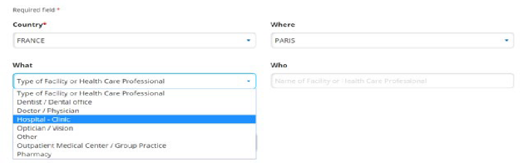

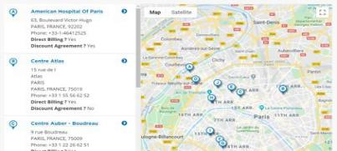
Accessing care
Stay in-network and save
Through your Global Medical Plan you have access to the Cigna Healthcare network of over 1.7 million providers with 400,000 outside the U.S.¹
Why stay in-network?
How to locate in-network providers?
Access to quality, affordable healthcare anywhere in the world
Manage your out-of-pocket costs through discounted rates and direct payment to doctors and hospitals
Reduce the overall cost of the Global Medical plan
Log onto www.CignaEnvoy.com OR download the Cigna Envoy mobile app
Select “Find a Provider” and choose your desired country from the drop down
Filter by location, provider type (i.e. hospital or doctor) or specialty
You may also contact Cigna Healthcare at any time for assistance.
1. Data from GHB Network analysis for full year 2022. Subject to change.

Slide 15
Digital tools

Slide 16

Simple self-service
Cigna Envoy®
Your digital portal to: (one experience via web or app)
Review plan information
Find a provider
Submit claims
Manage pharmacy needs
Access digital toolkit (ID cards, booklets, country guides, and more)
Multi-lingual

Slide 17



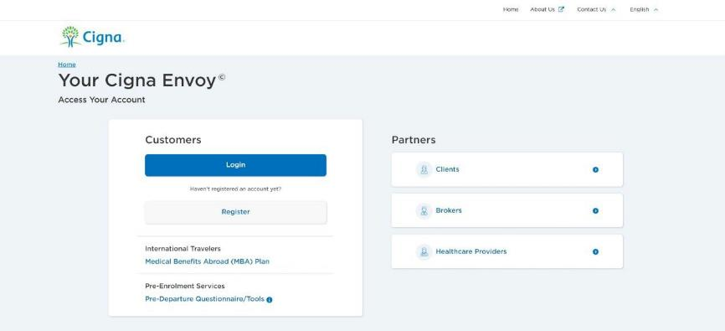
Registration
Click this option
With your Cigna Healthcare ID number found on your (ID card or welcome email) you can register for Cigna Envoy.
To register for the Cigna Envoy website, from your web browser navigate to www.CignaEnvoy.com and, within the “Customers” section, select “Register”.

Slide 18

Registering for Cigna Envoy
Registration is easy
Download the mobile app OR go to CignaEnvoy.com and, within the ‘Customers’ section, select ‘Register’.
Enter your Cigna Healthcare membership number into the ‘Cigna Healthcare ID’ field.
Enter your personal information from your membership card. Once all information is entered click the ‘Register’ button to proceed.
You will receive an activation email. Click on the link in the email to proceed with registration.
You are now asked to choose a security question for your account. If ever you forget your password, you can answer this question to gain access to the site. Once all information is entered, click ‘Continue’ to proceed.
You can now create your own password. Once all information is entered correctly, click ‘Continue’ to proceed.
You can choose to set up two factor authentication via email or text message.
You will be prompted to enter your verification code sent via text or email.

Slide 19
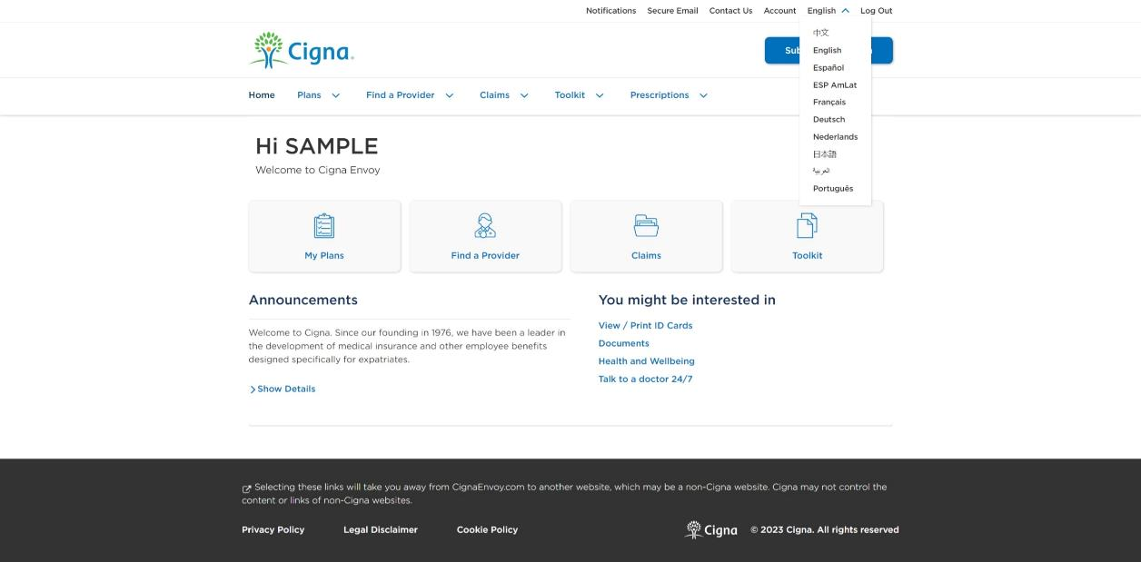

Cigna Envoy: Homepage
Cigna Envoy is available in:
Arabic
Chinese
Dutch
English
French
German
Japanese
Portuguese
Latin America Spanish
Spain Spanish

Slide 20
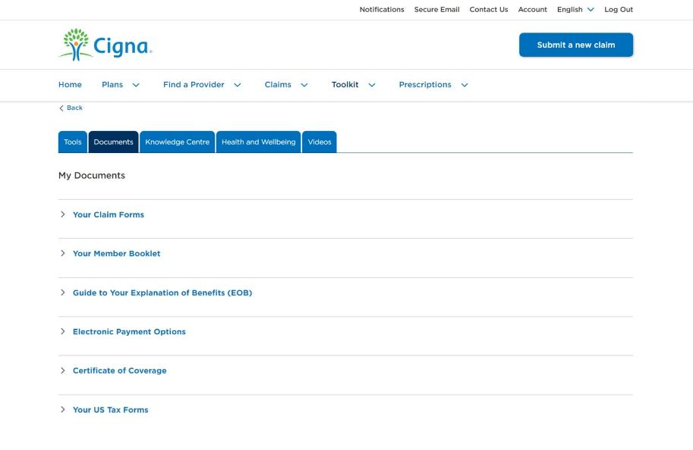
Certificates of Coverage
What is a Certificate of Coverage
Certificate of Coverage provides evidence of health coverage and is often needed for a visa application. Customers can log onto Cigna Envoy and obtain a copy of their certificate of coverage under the ‘Toolkit’ section*
The Certificate of Coverage will:
Auto-generate based on reported work location
Include employee and dependent information (if applicable)
*Online Certificates of Coverage will not generate for customers with no reported nationality and/or work location. Online Certificates of Coverage will not be available for customers with a reported nationality and/or work location in Iran, Syria, Ukraine, Cuba, North Sudan, or North Korea . Certificates of Coverage for expats in Germany, Russia, Turkey, Czech Republic, Switzerland, and Australia should continue to be requested through our Customer Service Team and will not be available online.

Slide 21

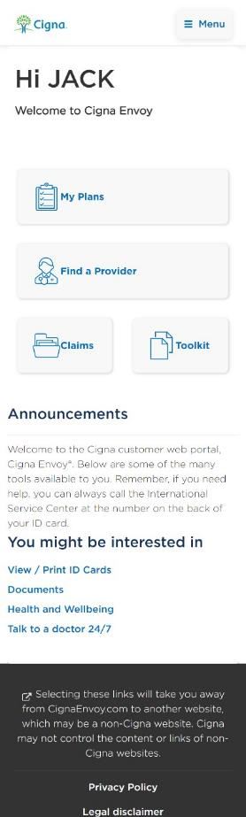

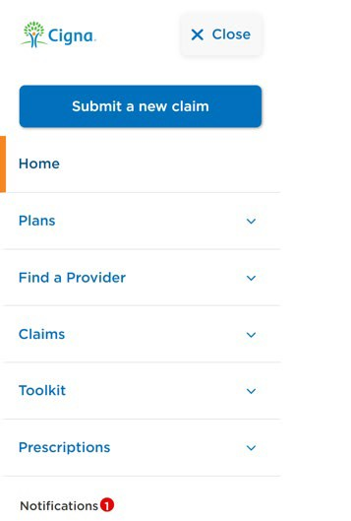
Cigna Envoy: Mobile app
At Cigna Healthcare, we are dedicated to making sure you have quick and easy access to your Cigna Healthcare benefits and services anytime and anywhere you need them.
That is why we created the Cigna Envoy mobile app. Cigna Envoy is the online source for your benefit needs and you can access it right on your smartphone.
Navigate the mobile app by:
Using the Home screen options
For more options, access the Menu, in the top right corner.

Slide 22
Health and wellbeing support

Slide 23

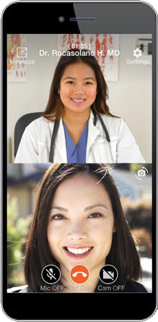
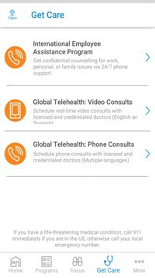
Access care through global telehealth
How can I use global telehealth?
What is global telehealth?
Cigna Healthcare customers can see a licensed doctor with private, online and live appointments via a secure video or phone conversation. Global telehealth provides:
24/7/365 access to a doctor within 24-72 hours available globally in multiple languages
Access to board certified doctors - internal medicine, gastroenterology, orthopedics, mental health specialists and pediatricians
Affordable and convenient alternative to doctor or clinic visits – with no deductibles or coinsurance, and no need to leave the house
Mobile app access to real-time scheduling
Diagnosis for non-emergency health issues – ranging from acute conditions to complex chronic conditions and pediatric care
Prescriptions on common health issues – when clinically necessary
Global telehealth is provided by Teladoc, an independent company. Some countries prohibit or limit the usage of telehealth. Telehealth may not be available in all areas or jurisdictions. Terms and conditions may apply.
23

Slide 24
Guided Health Advisor
There are two ways to access the questionnaire, depending on whether you have received your Cigna Healthcare ID card
With ID card
Visit CignaEnvoy.com and select ‘I have an existing login’. If you have not yet registered for Cigna Envoy, select ‘I have not registered yet’ and follow the prompts.
Select ‘Health and Wellbeing’ then ‘What to Know When Travelling & Relocating’. The pre-departure medical assessment will be the first option.
Without ID card
Visit CignaEnvoy.com and select ‘I do not have a ‘Cigna Healthcare ID/Pre-assignment tools’. Log in with your client ID number and password below:
User ID: PAR10123A
Password: 10123APAR (password is case sensitive)
Simple yet comprehensive online questionnaire that takes 10 minutes to complete
Fill out the questionnaire for yourself and any dependents who will be covered with you on your assignment
Identifies existing medical conditions
Learn how to manage or maintain your health while on assignment
Outreach from Cigna Healthcare* to help with current and/or potential issues
*You must select “yes” to the consent box in order to be contacted by the Cigna Healthcare Clinical Team
24

Slide 25

What to do if you become sick or injured
IF YOU BECOME ILL OR NEED TO SEEK CARE:
Locate a health care provider (HCP)
View our provider directory on CignaEnvoy.com OR contact Cigna Healthcare global customer service using the phone numbers on the back of your ID card to assist with a provider referral.
If you are in a CignaLinks location, the provider directory will alert you to network providers first.
WHEN YOU SEEK CARE:
Present your Cigna Healthcare ID card or CignaLinks ID card where applicable. If the provider is not part of our direct pay network ask for them to contact us directly so we can issue a Guarantee of Payment (GOP).
IF YOU ARE SERIOUSLY INJURED OR BELIEVE YOUR ILLNESS IS LIFE THREATENING:
Seek immediate help
Contact Cigna Healthcare global customer service as soon as possible so we can determine if the facility you are located at can properly handle your medical condition and/or facilitate a GOP if necessary.

Slide 26
Payment options, claim submissions, reimbursements

Slide 27
Fast and flexible: Claim submission
Multiple options, same great service
While we regularly make payments directly to the health care providers, our claims process is flexible. Medical, dental, vision, and prescription claims can be processed through:
If you receive care outside of our direct payment network, we have nearly a 100 percent success rate in establishing a guarantee of payment.
Direct payment
Guarantee of payment
Pay and claim
We have a robust provider network – with more than one million health care providers worldwide¹ – and we regularly make direct payments to doctors and hospitals willing to accept this arrangement. You can simply present your Cigna Healthcare ID card, and the doctor or hospital will bill Cigna Healthcare directly.
Please note: some direct pay providers may still require a GOP from Cigna Healthcare.
You also have the option of paying for services up front and submitting the claim to Cigna Healthcare for reimbursement. You can take advantage of our simple claims submission process through Cigna Envoy, the Cigna Envoy Mobile App, via toll-free fax or standard mail. Claim reimbursements are available in more than 135 currencies.²
Data from GHB Network analysis for full year 2022. Subject to change.
Data from GHB claims internal analysis as of February 2023. Subject to change

Slide 28

Requesting a guarantee of payment (GOP)
What is a guarantee of payment?
A Guarantee of Payment (GOP) allows doctors that may not participate in our network to verify eligibility and confirm benefits before you receive care.
Using a GOP increases your access to care around the world, reduces out-of-pocket expenses and enables the hospital to invoice Cigna Healthcare directly. GOPs can be requested by the customer or the provider.
Information Cigna Healthcare requires for a GOP
Patient name
Cigna Healthcare customer’s name and ID
Hospital, phone, email and fax
Hospital contact name, address and country
Diagnosis
Requested medical procedure
Admitting counselor/doctor
Cost Estimate (If a cost estimate is not received, a Verification of Benefits (VOB) may be issued instead of a GOP, which means no GOP is issued and only benefit coverage is confirmed).
Date of service (admission and discharge data)
If you are seriously injured or believe your illness is life threatening, please seek immediate care.
Then contact Cigna Healthcare +1-800-441-2668 so Cigna Healthcare can facilitate a GOP.

Slide 29
If you need to pay and submit a claim
Our medical and dental claims forms are available in 16 languages
Arabic | Chinese | Czech | Dutch | English | French | German | Hindi | Italian | Japanese | Korean | Portuguese | Russian | Spanish | Swedish | Thai
Submit using the photo claim submission tool through the Cigna Envoy mobile app.
CignaEnvoy.com
Cigna Envoy mobile App
Mail or fax
All registered users of our website, CignaEnvoy.com, are able to submit and view previous claims electronically using an easy-to-follow process.
Mail delivery:
Cigna Healthcare Customer Service Center
P.O. Box 15050
Wilmington, Delaware 19850
Fax: 1.800.243.6998

Slide 30

In the event you have to pay and claim
Submit your claim through CignaEnvoy.com or the Cigna Envoy mobile app. This is the fastest and easiest way to get your claims to Cigna Healthcare.
All out-of-network claims should be sent directly to Cigna Healthcare.
If you choose to mail or fax your claim(s), make sure your claim form is filled out completely, and don’t forget to sign it!
Fill out a separate form for each doctor or hospital visit.
Be sure to add a diagnosis, type of treatment or explanation of treatment.
Provide a detailed list of fees for each service rendered along with the date it was performed.
Make and keep handy copies of your bills, receipts and claim forms.
Clearly state how you would like to be reimbursed.
Remember: If you can’t submit your claim online or via the app, faxes are faster than regular mail.

Slide 31

Claim reimbursement options
Wire transfers¹ to bank accounts around the world.
Direct payment to a U.S. or Canadian bank.
Electronic Funds Transfers (EFT).
ePayment Plus® is an automated online payment system. With ePayment Plus, your reimbursement money is deposited directly into your bank account in one of the following countries:
Australia · Canada · Denmark · Hong Kong
New Zealand · Norway · Singapore · Sweden · UK
To sign up, go to CignaEnvoy.com.
Paper checks can be issued to you in over 135 currencies.²
1. Your bank, or intermediary banks, may apply a fee for the receipt of wire transfers. Cigna can only reimburse where legally permitted.
2. Data from GHB claims internal analysis as of February 2023. Subject to change.

Slide 32
Cigna Healthcare contact information
We want to hear from you!
Toll-free telephone number | +01 800.441.2668
Direct telephone number (reverse charges accepted) | +01 302.797.3100
Secure Email | www.CignaEnvoy.com

Slide 33
Questions

Slide 34
Product availability may vary by location and plan type and is subject to change. Products may not be available in all jurisdictions and are excluded where prohibited by law. All group health insurance policies and health benefit plans contain exclusions and limitations. For costs and details of coverage, review your plan documents or contact a Cigna Healthcare representative.
Cigna Healthcare products and services are provided exclusively by or through operating subsidiaries of The Cigna Group, including Cigna Health and Life Insurance Company, Cigna Life Insurance Company of Canada, Cigna Global Insurance Company Limited, Evernorth Care Solutions, Inc., and Evernorth Behavioral Health, Inc. The Cigna Healthcare name, logo, and other Cigna marks are owned by Cigna Intellectual Property, Inc., licensed for use by The Cigna Group and its operating subsidiaries. “Cigna Healthcare” refers to The Cigna Group and/or its subsidiaries and affiliates.

